Slide 1
VALUE questionnaire on end-user needs
Lisboa, 26.3.2013
WG1

Slide 2
Challenges in Downscaling
both sides need to evaluate their limits
«Impact community»
«Climate community»

Slide 3
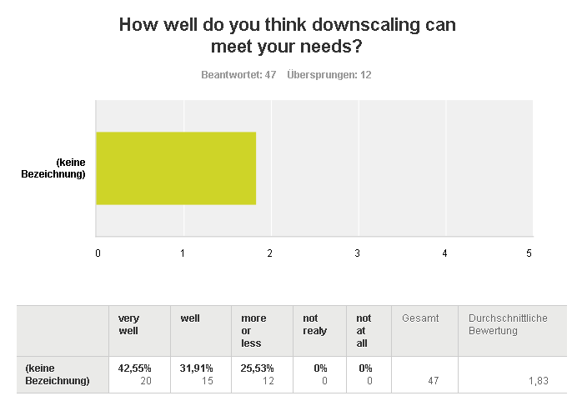
Importance of DS

Slide 4
Questionnaire
60 responses
Many different sectors
All parts of Europe
Every elevation (hydrology especially in Montains)
Most impact modellers
Some important sectors missing

Slide 5
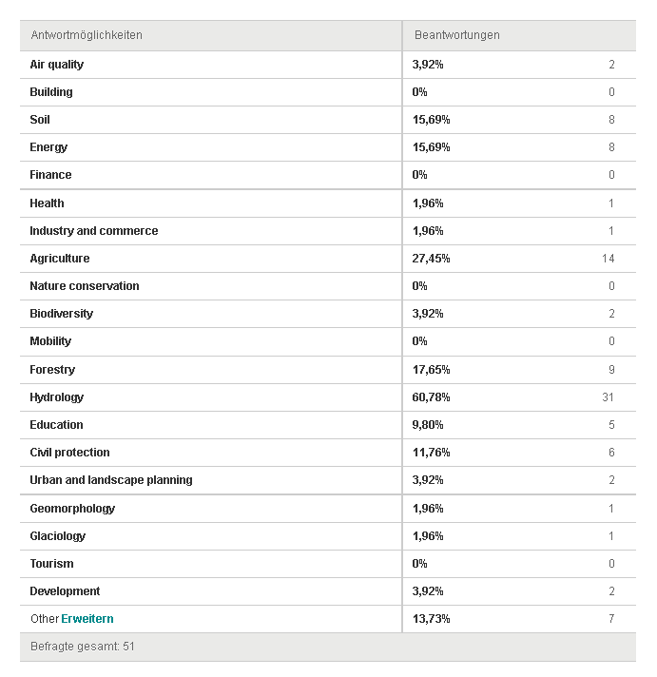
Who answered

Slide 6
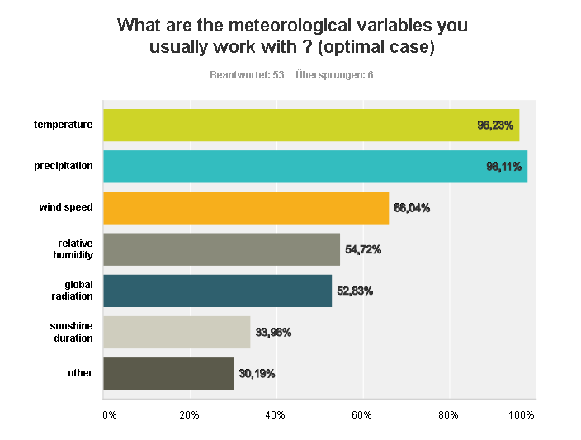
What variable to you usually work with?
Major two or „the big five“

Slide 7
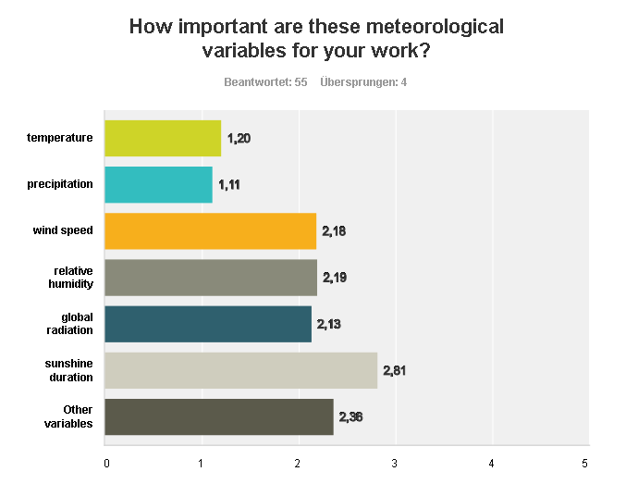
What variable to you usually work with?
Major two or „the big five“

Slide 8
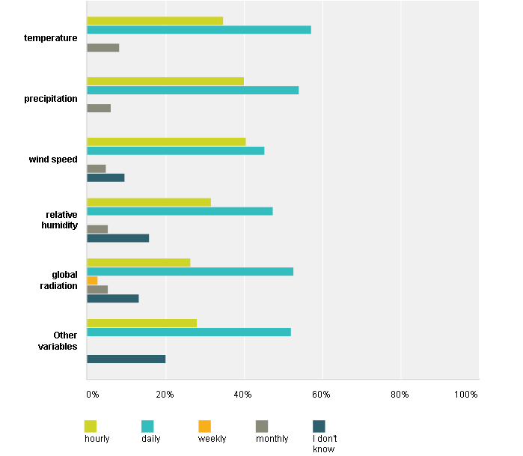
Temporal resolution
daily subdaily

Slide 9
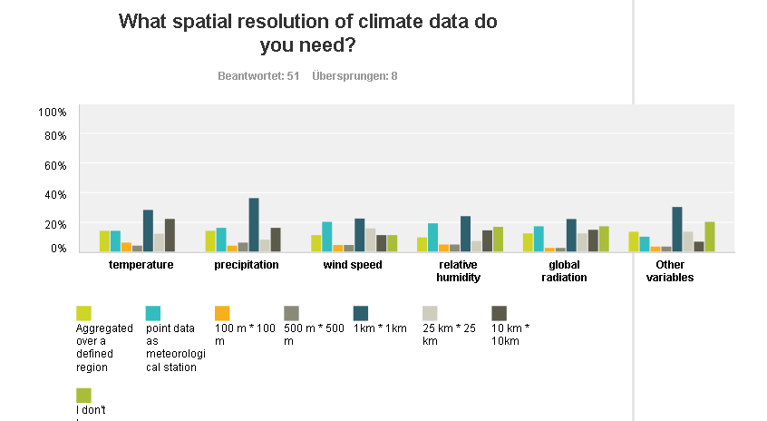
Spatial resolution – quite diverse
1 km, point data, region

Slide 10
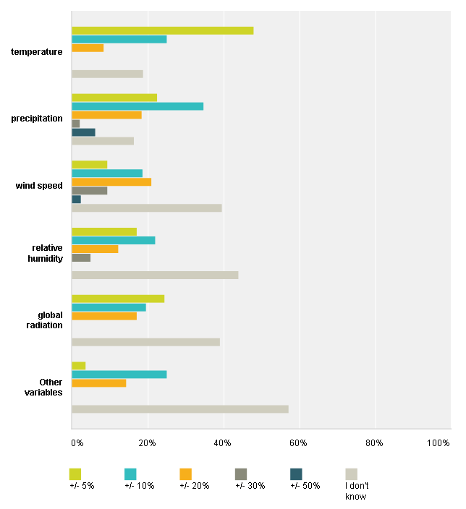
Accuracy –
Best case

Slide 11
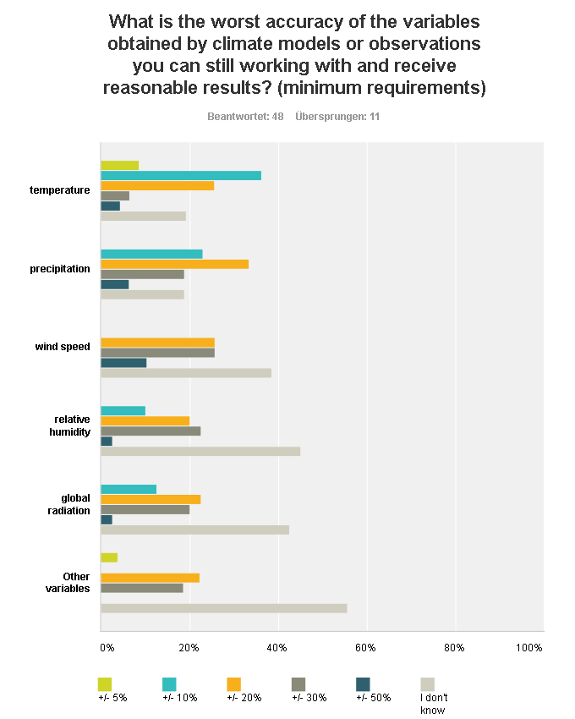
Accuracy –
Worst case

Slide 12
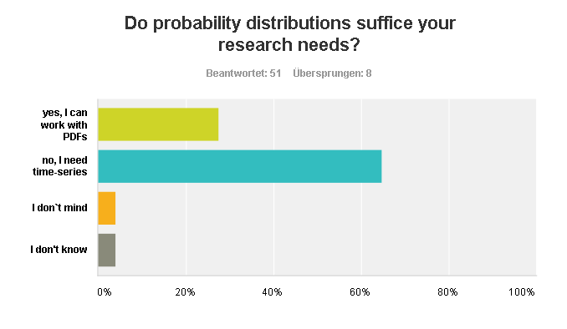
PDFs or time series

Slide 13
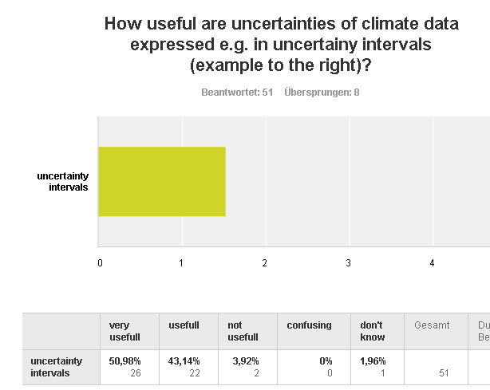
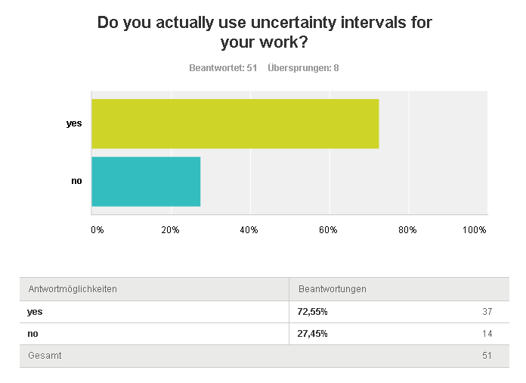
Uncertainties –
usefull
applied

Slide 14
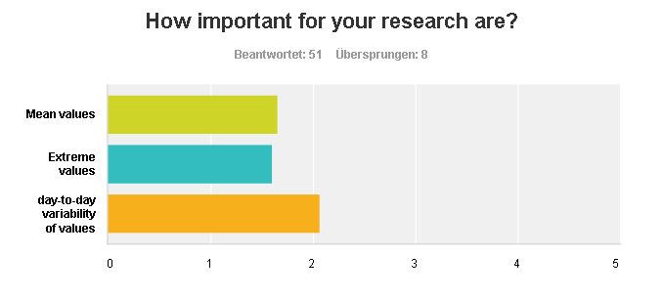
Ranking the needs
First mean and extreme, than variability

Slide 15
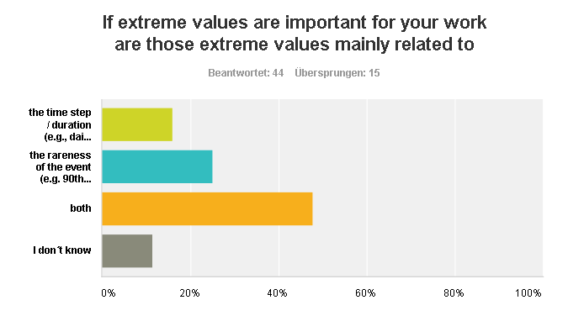
Extreme II

Slide 16
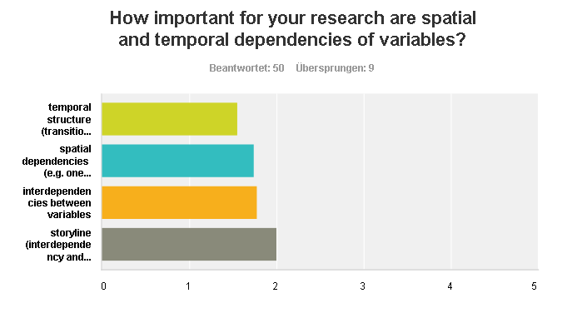
Temporal and spatial dependencies
Nice to have…

Slide 17
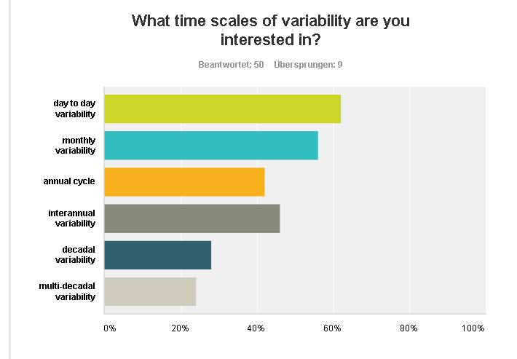
Time scale of variability
daily

Slide 18
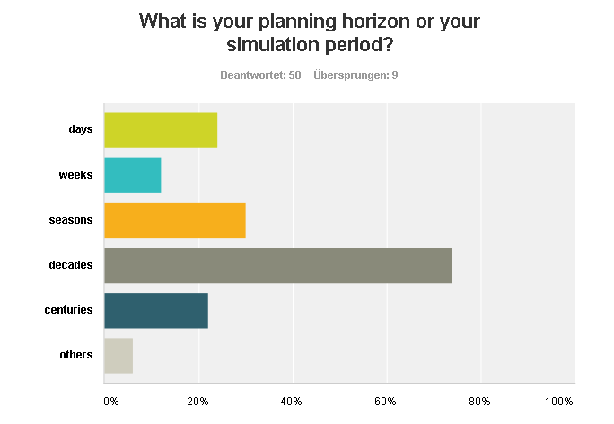
Planing horizont

Slide 19
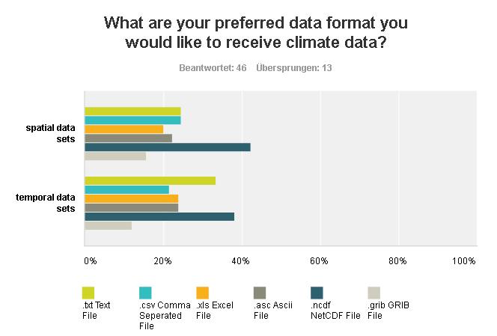
Data format

Slide 20
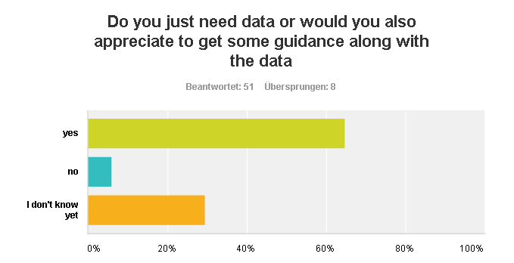
Guidance is needed

Slide 21
Accuracy –
Worst case

Slide 22
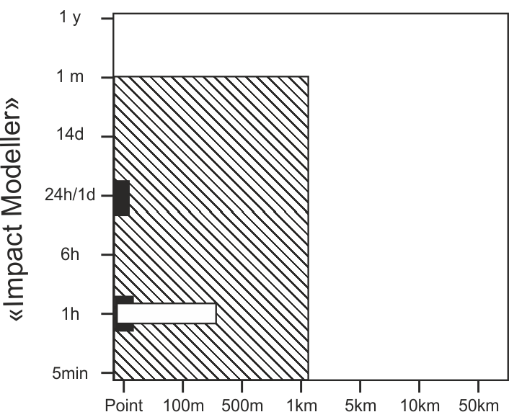
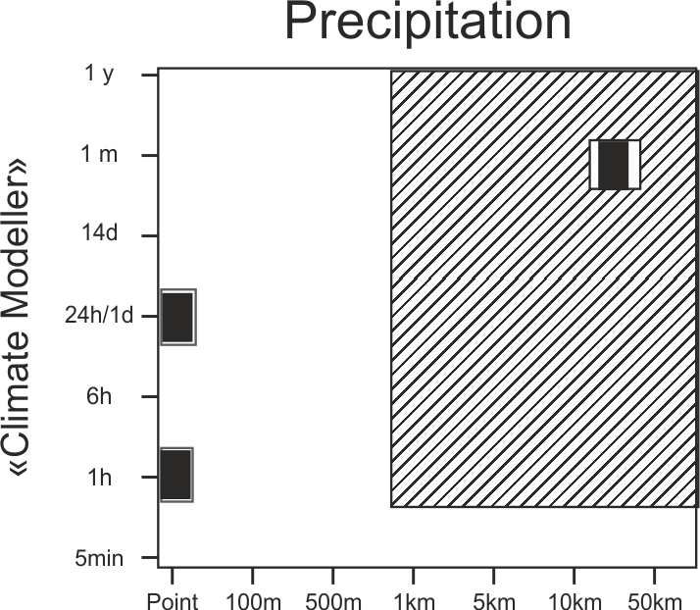
Challenges in Downscaling
Combined area of comfort
both sides need to evaluate their limits
«Impact modeller»
«Climate modeller»

Slide 23
Combined area of comfort

Slide 24
Conclusion and Furthcoming tasks
We know a bit better what end-users need
Some sectors are missing and should be incorporated in the future (WG2)
Define the climate communities area of comfort
What can we provide? (WG2-WG5)
Enforce the end-user community to think about their minimum requirements (WG1, all)

Slide 25
Thank you for your help in the questionnaire!!!

Slide 26
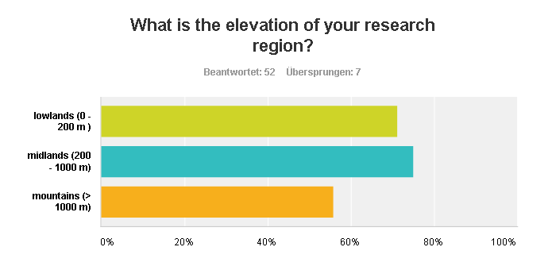
Who answered the questionnaire II

Slide 27
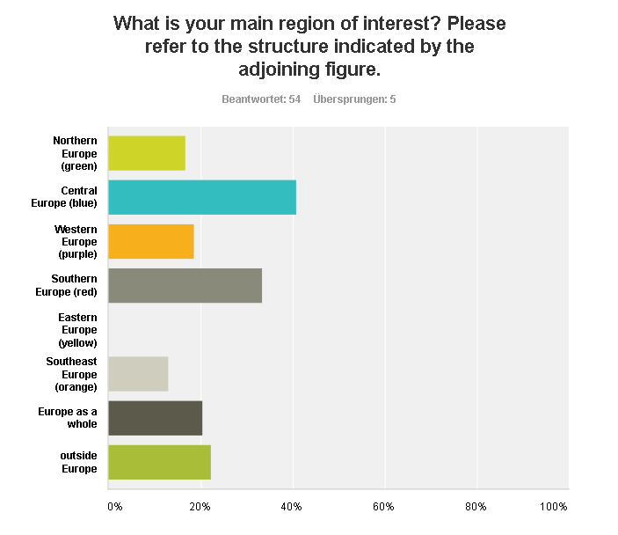
Who answered the questionnaire?
Equally distributed

Slide 28
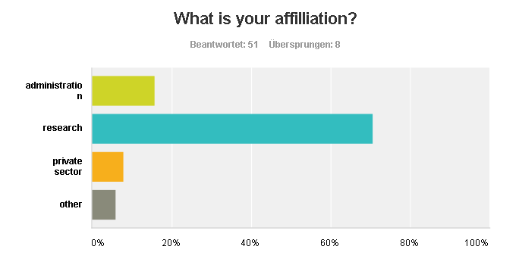
Who answered the questionnaire II

Slide 29
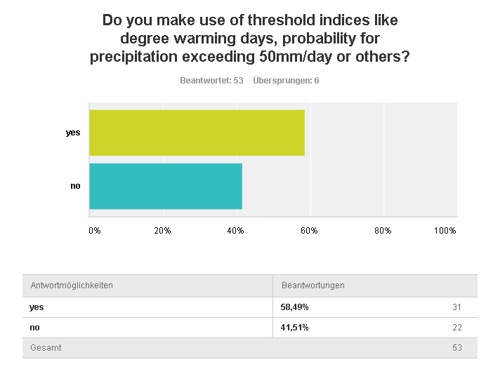

Slide 30
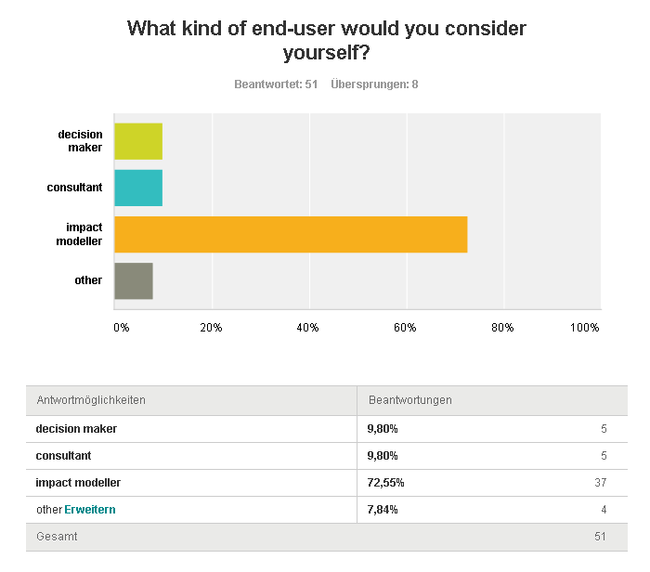
Who answered the questionnaire II

